Slide 1
DESIGN OF A STOCK PRICE PREDICTION SOFTWARE BASED ON 6 MONTHS DATA BY OBIECHINA EMMANUEL IKENNA - 2017/243977 NWEZE MATTHEW UDOCHUKWU - 2017/247495 OZOR GIFT TOCHUKWU - 2017/247631

Slide 2
CONTENT
The Stock Market
Importance of Stock Market
Understanding Machine Learning
Types of Machine Learning
Programming Languages used in Machine Learning
Predicting the Stock Price of Google
Algorithm
Implementation
Result
Conclusion
References

Slide 3
THE STOCK MARKET
A stock market, equity market, or share market is the aggregation of buyers and sellers of stocks (also called shares), which represent ownership claims on businesses; these may include securities listed on a public stock exchange, as well as stock that is only traded privately, such as shares of private companies which are sold to investors through equity crowdfunding platforms. . The stock market allows buyers and sellers of securities to meet, interact, and transact. When a company wants to raise capital to finance its operations, expansion, or other initiatives, it may choose to go public by issuing shares. These shares represent ownership in the company and are typically divided into smaller units known as stocks. The company's shares are then listed on a stock exchange, which can be a physical location or an electronic platform where trading occurs.

Slide 4
IMPORTANCE OF STOCK MARKET
Stock markets help companies to raise capital: Stock markets play a crucial role for companies, as they can raise capital through initial public offerings without the need for loans from banks. This allows companies to access significant funds without the burden of repayment and interest.
It helps generate personal wealth: For an individual investor, the Stock Market provides a platform to invest your income and own a share of the company’s profit.
Stock markets serve as an indicator of the state of the economy: This means that the stock market serves as barometer for the economy; the rise or fall in the price of shares indicates what cycle the economy is in, such as a recession or a boom etc.

Slide 5
UNDERSTANDING MACHINE LEARNING
Machine learning (ML) is the subset of Artificial Intelligence (AI) that focuses on building systems that learn—or improve performance—based on the data they consume. It is based on the idea that computers can analyze and interpret large amounts of data to discover patterns, extract insights, and improve their performance over time. AI is a broad term that refers to systems or machines that mimic human intelligence. ML and AI are often discussed together, and the terms are sometimes used interchangeably, but they don’t mean the same thing. An important distinction is that although all ML is AI, not all AI is ML.

Slide 6
MACHINE LEARNING VS. DEEP LEARNING VS. NEURAL NETWORKS
Since Deep Learning and ML tend to be used interchangeably, it’s worth noting the nuances between the two. ML, Deep Learning and Neural Networks are all sub-fields of AI. However, Neural Networks is actually a sub-field of ML, and Deep Learning is a sub-field of Neural Networks. The next slide shows the relationship between the three.

Slide 7
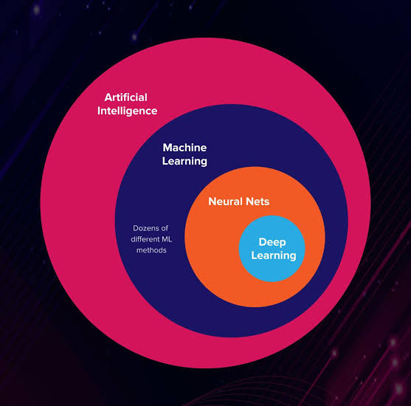
RELATIONSHIP BETWEEN MACHINE LEARNING VS. DEEP LEARNING VS. NEURAL NETWORKS

Slide 8
TYPES OF MACHINE LEARNING
Supervised Machine Learning: Supervised machine learning models are trained with labeled data sets, which allow the models to learn and grow more accurate over time. For example, an algorithm would be trained with pictures of dogs and other things, all labeled by humans, and the machine would learn ways to identify pictures of dogs on its own.
Unsupervised Machine Learning: Unsupervised machine learning involves training based on data that does not have labels or a specific, defined output. For example, an unsupervised machine learning program could look through online sales data and identify different types of clients making purchases.
Reinforcement machine learning: Reinforcement machine learning trains machines through trial and error to take the best action by establishing a reward system. An example of reinforcement learning occurs when computers learn to play video games by themselves. The algorithm keeps on interacting with the game environment through series of actions and the environment in turn, gives punishment or a reward based on the nature of action taken.

Slide 9
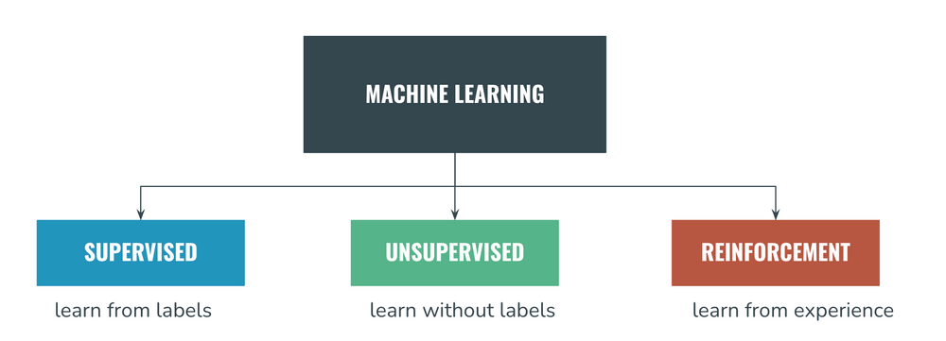

Slide 10
PROGRAMING LANGUAGES USED IN MACHINE LEARNING
Python: Python is the most popular programming language for machine learning due to its simplicity, readability, and a vast ecosystem of libraries and frameworks such as TensorFlow, PyTorch, and scikit-learn. Python's versatility, combined with its rich set of data manipulation and visualization tools, makes it an excellent choice for beginners and experts alike.
Others include:
R
Java
Julia
C++

Slide 11
PREDICTING THE STOCK PRICE OF GOOGLE
GOOGLE STOCK PRICE DATASET
Google LLC is an American multinational technology company that specializes in Internet-related services and products, which include online advertising technologies, a search engine, cloud computing, software, and hardware. It is considered one of the big four Internet stocks along with Amazon, Facebook, and Apple.
The company is listed on the NASDAQ stock exchange under the ticker symbol GOOG.
We have included 6 months Stock Price of Google for this Project.

Slide 12
ALGORITHM
The algorithm used for this project is the Long-Short Term Memory (LSTM). LSTM is a type of Recurrent Neural Network (RNN) that is specifically designed to handle sequential data. Or simply put, it is a variety of recurrent neural networks (RNN) that is capable of learning long-term dependencies, especially in sequence prediction problems. It is a technique of deep learning and was invented to tackle the issue of vanishing gradients that we face in long sequences. The LSTM RNN model addresses the issue of vanishing gradients in traditional Recurrent Neural Networks by introducing memory cells and gates to control the flow of information and a unique architecture. Gradient vanishing refers to the loss of information in a neural network as connections recur over a longer period. In simple words, LSTM tackles gradient vanishing by ignoring useless data/information in the network. LSTM is made up of three gates: the forget gate, the input gate, and the output gate. These gates learn their weights and determine how much of the current data sample should be remembered and how much of the past learned content should be forgotten.

Slide 13
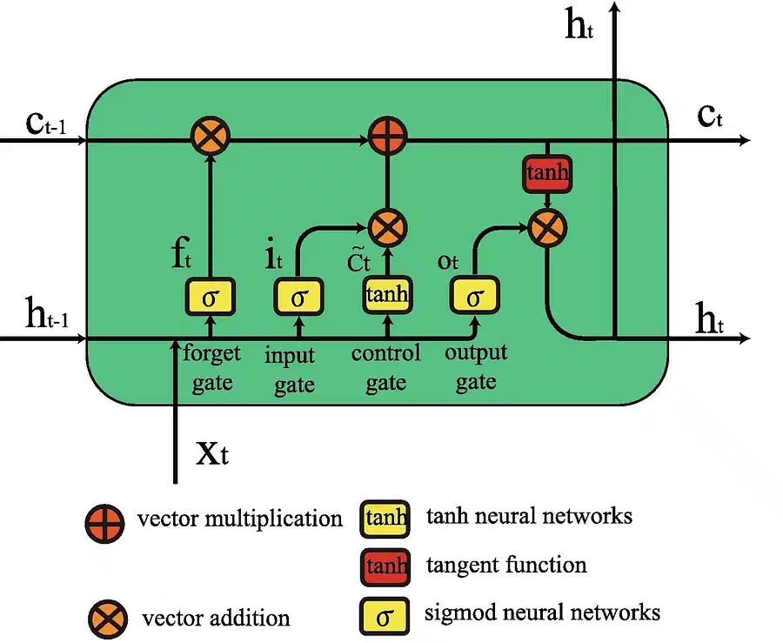
LSTM ARCHITECTURE

Slide 14
By using the forget, input, and output gates, an LSTM model can effectively capture long-term dependencies in sequential data. The gates enable the model to selectively retain important information, forget irrelevant information, and output relevant information at the appropriate time step. In summary, the forget gate decides what information and how much of it can be erased from the current cell state, while the input gate decides what will be added to the current cell state. The output gate, controls the magnitude of output computed by the first two gates.

Slide 15
IMPLEMENTATION
DATASET COLLECTION AND DESCRIPTION
We used a Google stock dataset downloaded from finance.yahoo.com. The dataset has historical stock data collected over 6 months. It contains 127 valid records or data points, gathered between July 1, to December 31, 2022. The attributes are as follows:
Date: The corresponding date of the event.
Opening price: The price at which a stock first trades upon on a trading day.
High: This is the highest value of a stock in a trading day
Low: It refers to the lowest value of a stock in a trading day
Closing Price: A stock’s closing price is the final price at the end of a trading day.
Adjacent close: It is the value of the stock after a dividend is posted, where a stock dividend is a dividend paid to shareholders rather than as cash in the form of additional shares in the company.
Volume: This refers to the volume of stocks traded in a trading day.

Slide 16
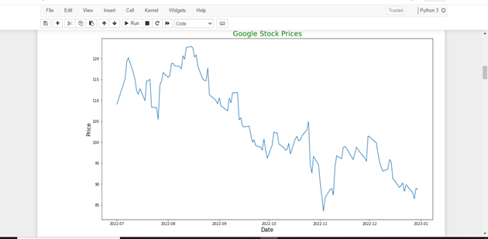
Figure of Google stock price from July 1st to December 31st 2022

Slide 17
DATA PROCESSING
Predicting complex data such as Google stock price is one of the various difficult tasks in ML. This is due to the complexity, irregularity and non-linear nature of the data; hence, the need to convert the data into a structured format. In order to convert the dataset into a structured manner, we performed several data processing techniques such as data split, data normalizing, and dimensional conversion over training and testing sets. We also need to normalize our data so that all the values are ranged from 0 to 1. In our case, we used Scikit- learn’s MinMaxScaler to scale our dataset to numbers between 0 and 1.
Training and Testing split: For evaluation purpose, we divided the dataset into two segments: training and testing. 80% of the data would be used to train the model while the remaining 20% would be kept to test the model.

Slide 18
TRAINING THE LSTM MODEL
To train the model, we need to work with Python libraries. Some of the libraries we used include NumPy for scientific computation, Matplotlib for plotting graphs, and Pandas to aide in loading and manipulating our datasets. Like most other Python packages, these libraries can be installed using pip, like: pip install pandas numpy matplotlib tensorflow. The LSTM model was trained using Tensorflow Keras library.
A couple of modules was imported from the Keras library, which was used in training the model. Some of which includes: Sequential for initializing the neural network, LSTM for adding the Long Short-Term Memory layer, Dense for adding a densely connected neural network layer.
The model was then trained by fitting it with the training set. We used a batch_size of 1 and allowed it to run for 15 epochs.

Slide 19
RESULT
The value of Google stock was initially scaled using the min-max scaler. For this data to be meaningful to the user, the values need to be scaled back to its original prices; hence, the inverse-transform function was used to scale back the values of the Google stock to its original prices.
The Root Mean Square Error (RMSE) was calculated to check the accuracy of the model. . RMSE is calculated by taking the square root of the average, specifically the mean, of errors squared between the predicted and actual values of a parameter of a model. This calculation was performed on both the train dataset and the test dataset as well. The RMSE for the Test set was gotten as 0.83 while that of the Training set was 1.28.

Slide 20
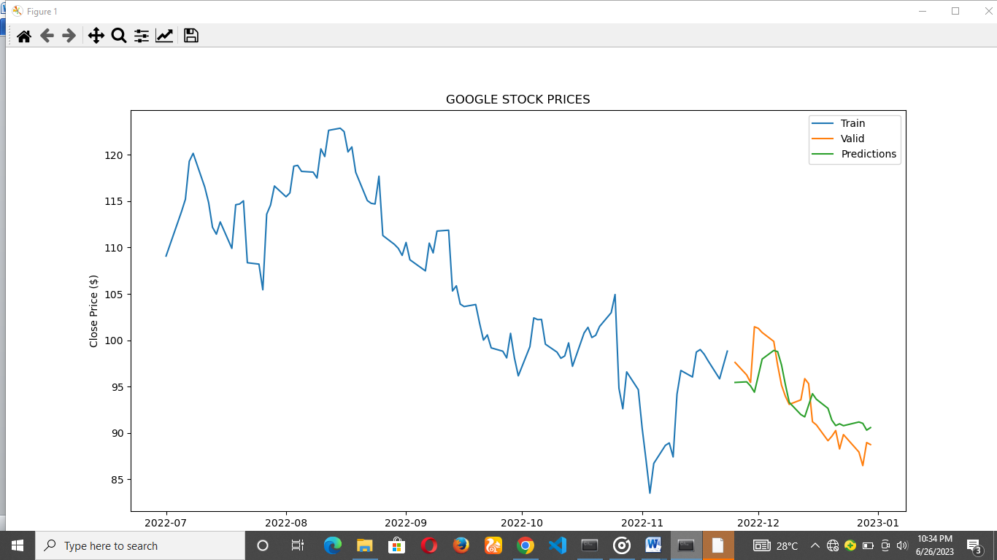
Actual and Predicted price of Google stock using LSTM

Slide 21
CONCLUSION
From the figure above, it can be clearly observed that the predicted stock prices follow the trend of the real stock prices closely. This shows the effectiveness of the LSTM to work with time series or sequential data like the stock prices.
However, the dataset used for this project is relatively small in the field of ML, hence, it was unable to properly harness the advantages of ML in its ability to scale big data in this setting.
It is important to note that stock price prediction using LSTM models is not without challenges. The financial markets are influenced by numerous factors, including economic indicators, news events, and geopolitical developments, which can significantly impact stock prices. LSTM models primarily rely on historical price patterns and do not incorporate real-time information, making them susceptible to sudden market shifts and unforeseen events.

Slide 22
REFRENCES
“What Is the Stock Market, What Does It Do, and How Does It Work?” https://www.investopedia.com/terms/s/stockmarket.asp (accessed Feb. 20, 2023).
“Stock Market: Definition and How It Works - NerdWallet.” https://www.nerdwallet.com/article/investing/what-is-the-stock-market (accessed Aug. 06, 2023).
“Stock market prediction - Wikipedia.” https://en.wikipedia.org/wiki/Stock_market_prediction (accessed Feb. 20, 2023).
“What is Machine Learning? | Oracle Nigeria.” https://www.oracle.com/ng/artificial-intelligence/machine-learning/what-is-machine-learning/ (accessed Aug. 06, 2023).
“AI vs. Machine Learning vs. Deep Learning vs. Neural Networks: What’s the difference?” https://www.ibm.com/blog/ai-vs-machine-learning-vs-deep-learning-vs-neural-networks/ (accessed Aug. 06, 2023).
“Recurrent Neural Networks and LSTM: Overview and Uses | Turing.” https://www.turing.com/kb/recurrent-neural-networks-and-lstm (accessed Aug. 06, 2023).
S. Hochreiter and J. Schmidhuber, “Long Short-Term Memory,” Neural Comput, vol. 9, no. 8, pp. 1735–1780, Nov. 1997, doi: 10.1162/NECO.1997.9.8.1735.

